Slide 1

Software Approach To Enigma Machine
PROJECT EXHIBITION-II
Review- 1

Slide 2

Team Members :-
M.Pon Dinesh Kumar
Yogesh Panchal
Sourabh Sahu
20MEI10010
20MEI10026
20MEI10033
Debroop Sarkar
20MEI10078
Guided By- Dr.Raja Soundaran

Slide 3

Introduction
What is Enigma Machine?
An Enigma machine is a electro mechanical rotor cipher machines used for the encryption and decryption of secret massages.
In World War II, the Nazi military employed an encryption scheme that addressed the weakness of substitution ciphers. The scheme, implemented by typewriter sized devices known as Enigma machines, gave the Nazis a tactical advantage that greatly contributed to their early success in the war.
Using computers, the Allies were eventually able to break the Enigma code, giving them an intelligence edge that changed the balance of the war.

Slide 4

Objective
Enigma Machine has played an important role in the history of computing, from motivating the development of the first electronic computer to enabling secure Web-based communication and commerce. This program enable us to know the role of encryption in military and computing history, and have a deep look into the mechanism of Enigma machine.
The needs of data protection.

Slide 5

Problem statement
What do we want to do?
We want to write a program to simulate the Enigma machine to decrypt the secret code produced by the Enigma machine.
There is no weighting factor associated with different plaintext letters. Checking all 159 X 10^18 possible letter substitutions, even by machine, was clearly impractical and that's just for one message. The security and intelligence services however had to decrypt several thousand messages every day. The machine settings were also changed daily so that any minor decryption discoveries would have a very limited useful lifetime.
The Enigma Code was therefore thought to be unbreakable.

Slide 6

Literature Review :-
Data encryption and decryption Encryption is the process of translating plain text data (plaintext) into something that appears to be random and meaningless (ciphertext). Decryption is the process of converting ciphertext back to plaintext.To encrypt more than a small amount of data, symmetric encryption is used. A symmetric key is used during both the encryption and decryption processes. To decrypt a particular piece of ciphertext, the key that was used to encrypt the data must be used.
The goal of every encryption algorithm is to make it as difficult as possible to decrypt the generated ciphertext without using the key. If a really good encryption algorithm is used, then there's no technique significantly better than methodically trying every possible key. For such an algorithm, the longer the key, the more difficult it is to decrypt a piece of ciphertext without possessing the key.It's difficult to determine the quality of an encryption algorithm. Algorithms that look promising sometimes turn out to be very easy to break, given the proper attack. When selecting an encryption algorithm, it's a good idea to choose one that's been in use for several years, and has successfully resisted all attacks.For more information, see Data encryption and decryption functions.

Slide 7

Proposed Work /Method:
How It Works?
Rotating Ciphers
After each letter is encoded, the key is rotated so that the first character is moved to the end.
Example: a b cdef→ hjasdb
encode: a a a⇒hjaob
encode: a b c → had
It is a combination of three rotating rotor (wheel).
The inner rotor rotate one step after every single character is encrypted.
The middle rotor rotate one step after the inner rotor complete a round of rotation.
It is a combination of three rotating rotor.
The inner rotor rotate one step after every single character is encrypted.
The middle rotor rotate one step after the inner rotor complete a round of rotation.

Slide 8

Real Time Usage
In this technological world it will protect information using incrypt and decrypt method.
This is also use for our military base where they can use software approach method and communicate with each other.

Slide 9

Hardware & Software Requirements
HARDWARE REQUIREMENTS
SOFTWARE REQUIRERMENTS
One PC
Processor – Min Core i3
RAM – Min 4GB
SSD – 256GB/128GB
System Bus:- Either 32-Bit or 64-Bit
Keyboard:- Windows compatible
Processing 4 software
Operating Environment :-
Windows XP/Vista/7/8, Mac OSX,
Linux

Slide 10
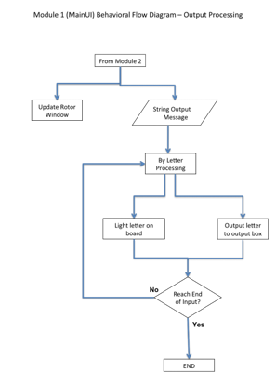
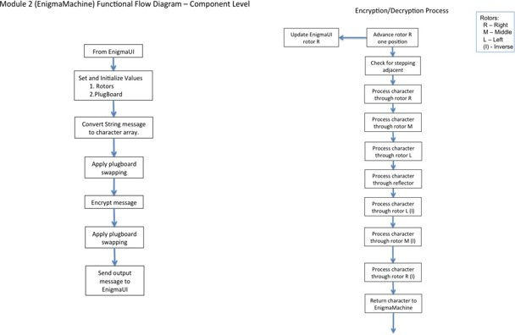




Overall System Architecture Diagram

Slide 11
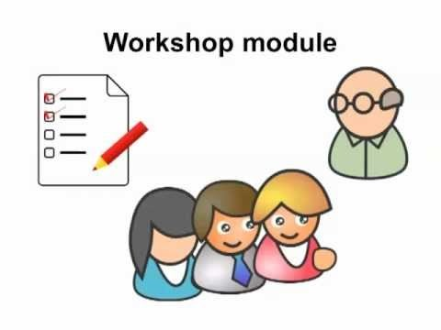
Modules & Explanation
A German Enigma operator would be given a plaintext message to encrypt. After setting up his machine, he would type the message on the Enigma keyboard. For each letter pressed, one lamp lit indicating a different letter according to a pseudo-random substitution determined by the electrical pathways inside the machine.
We divided our system different modules –
Enigma
EnigmaSim
Light
Plugpoint
Rotor

Slide 12

Project Timeline
Phase-1
Phase-3
Phase-2
Work On Program
Submit Project Report before TEE
Review-1
Program Implementation and Demo
Phase-4

Slide 13
Refrences
https://www.mpoweruk.com/enigma.htm
https://arxiv.org/pdf/2004.09982
https://www.researchgate.net/publication/314935733_The_Enigma_Machine
http://www.cryptomuseum.com/crypto/enigma/hist.htm

Slide 14


